Slide 1
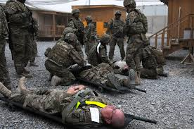
Unit Ministry Team Response to a Mass Causality (MASCAL)

Slide 2


Slide 3
Terminal Learning Objective
Develop the Unit Ministry Team’s response to a MASCAL situation IAW AR 165-1 Army Chaplain Corps Activities

Slide 4
Enabling Learning Objective
      Define the medical terms used during MASCAL situations IAW ATP 4-25.13 Casualty Evacuation dated February 2013
      Understand the layout of the MASCAL environment IAW Local Unit MASCAL SOP
      Identify the types of religious support functions that are needed during the MASCAL Response IAW

Slide 5
Military Treatment Facilities
ROLE 1 Unit-Level Medical Care
ROLE 2 Medical Company
ROLE 3 Combat Support Hospital
ROLE 4 Military Hospitals CONUS and OCONUS

Slide 6
Mass Casualty
Any large number of casualties produced in a relatively short period of time, usually as the result of a single incident such as a military aircraft accident, hurricane, flood, earthquake, or armed attack that exceeds local logistical support capabilities.

Slide 7
Triage
The word triage comes from the French word trier which mean to divide into three.
Baron Dominique Jean Larrey used the triage concept on the battlefield to sort out patients in three categories of Immediate, Urgent, and Non-urgent.
Triage is a process for sorting injured people into groups based on their need for or likely benefit from immediate medical treatment.
Triage is used on the battlefield, at disaster sites, and in hospital emergency rooms when limited medical resources must be allocated

Slide 8
Medical Triage Categories
Priority | Category | Color Code
1 | IMMEDIATE | RED
2 | DELAYED | YELLOW
3 | MINIMAL | GREEN
4 | EXPECTANT | BLACK
Additional Categories
 | Psychiatric | Grey
 | Family Staging Area | Grey

Slide 9
Evacuation
Casualty Evacuation:
Movement of casualties using non medical assets
Minimum medical aid is giving during this method
Medical Evacuation:
Movement of casualties using medical assets established medical equipment and personnel

Slide 10
Collection Points
Casualty Collection Point (CCP):
Location where casualties are staged and triaged for evacuation to the MTFs
Ambulance Exchange Point:
Locations where casualties are exchanged from one evacuation platform to another.

Slide 11
Understanding the MASCAL environment
Unit SOP’s will dictate the Layout of the MASCAL site.
The MASCAL Layout allows for the controlled flow of Casualties from point of injury to the necessary level of care

Slide 12
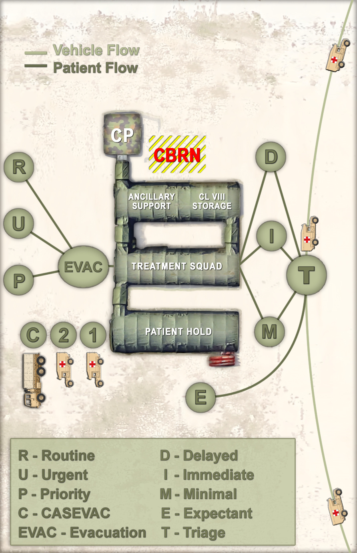

Slide 13
MASCAL environment Considerations
Restricted Access to treatment areas
A single triage point
The need for decontamination
Physical Separation of each category.

Slide 14
Religious Support to the MASCAL
Religious support will always be broken down into the three core competencies:
Nurture the Living
Care for the Wounded
Honor the Fallen

Slide 15
Religious Support to the MASCAL
The Chaplain takes the lead on the initial assessment for religious support.
The Religious Affairs Specialist then moves ahead of the Chaplain to determine where the Chaplain should be next.
In order to provide the most comprehensive religious support in the MASCAL environment the UMT must conduct a spiritual triage. Similar to the medical triage the spiritual triage considers the ability for a single UMT to provide the most effective religious support to the casualties.

Slide 16
Spiritual Triage
Religious preference of the casualty vs the Faith of the Chaplain and Religious Affairs Specialist.
Priority of effort to the Immediate vs Expectant.
Religious Support to the medical and support personnel.

Slide 17
Spiritual Triage
Religious preference can be identified by asking the casualty, reading the casualties identification tags, or coordinating with the Patient Admin Department (PAD).
When available the UMT should document any religious support provided on the casualties DD 1380.

Slide 18
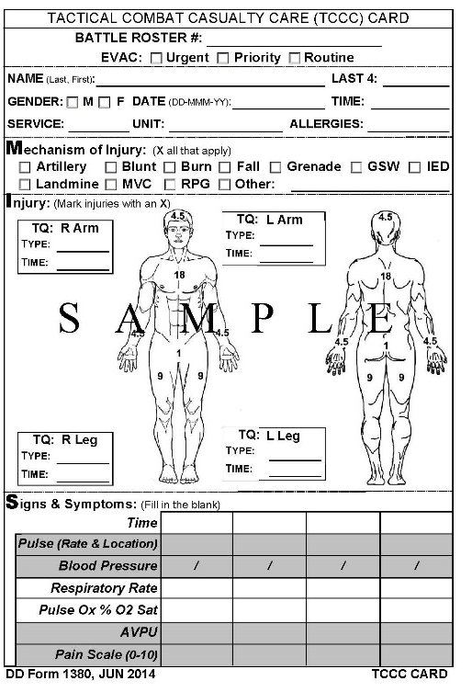
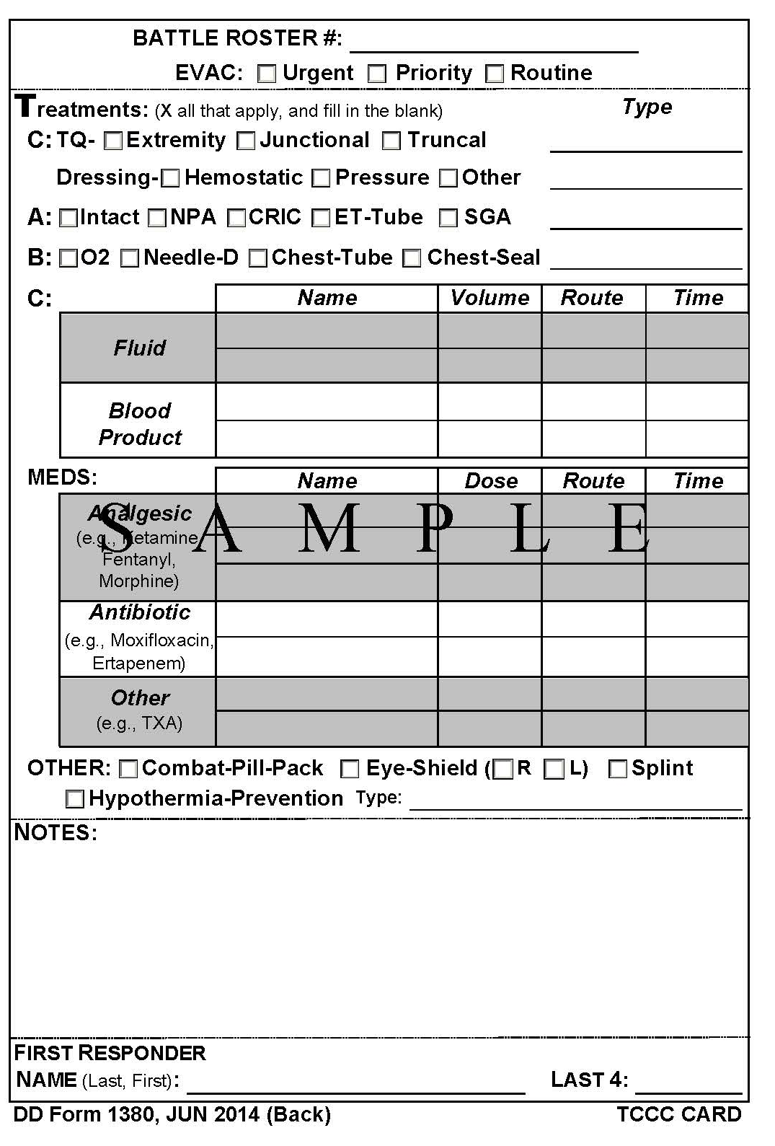
DD Form 1380

Slide 19
UMT Operations during MASCAL
The use of Personnel Protective Equipment (PPE).
The threat level and security of the MASCAL site.
After the initial assessment of the MASCAL situation the UMT should request for additional support identified in the Religious Support Plan.
For prolonged Religious Support during a MASCAL additional UMTs should be ready and available to switch out with current UMTs. This reduces the risk of UMT burn out and increases the effectiveness of religious support.

Slide 20
Questions

